Slide 1

Dermatoscopy of inflammatory lesions: Important criteria and pathologic correlation
Harald Kittler, MD

Slide 2
Important dermatoscopic criteria
Vessels
Scale
Follicular structures
Background
Clues

Slide 3
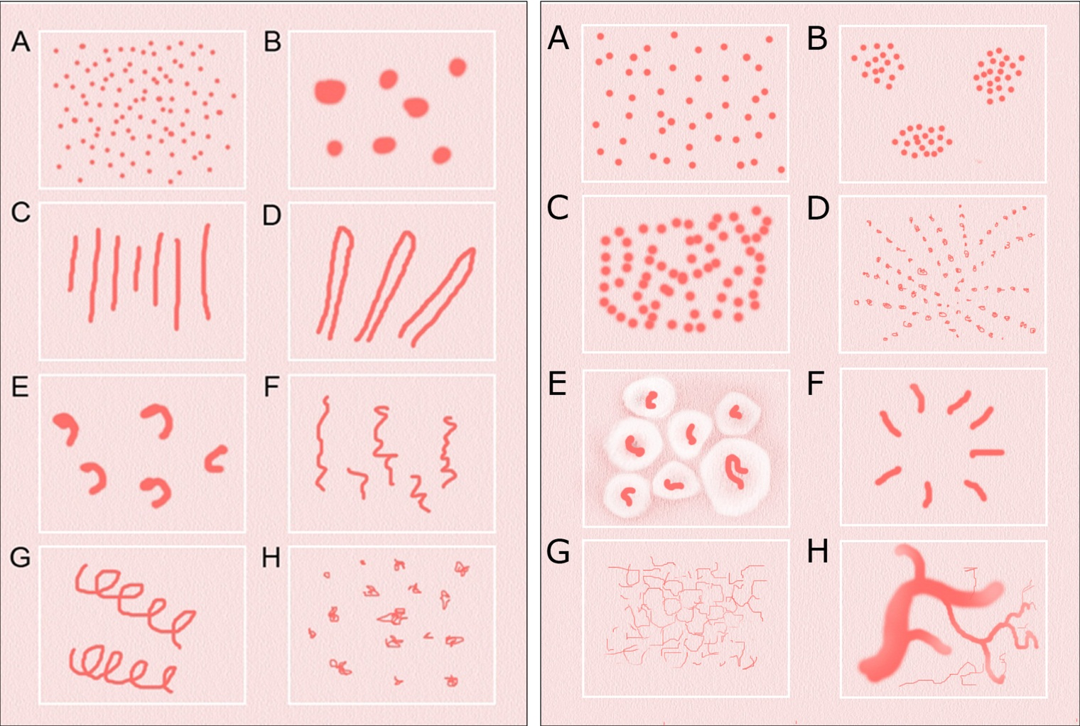
Morphology
Arrangement
Vascular patterns:
Vessel morphology left: A- dots; B- clods; C- lines; D- looped; E- curved;
F- serpentine; G- helical; H- coiled
Vessel arrangement right: A- random; B- clustered; C- serpiginous,
D- linear; E- centred; F- radial; G -reticular; H- branched

Slide 4
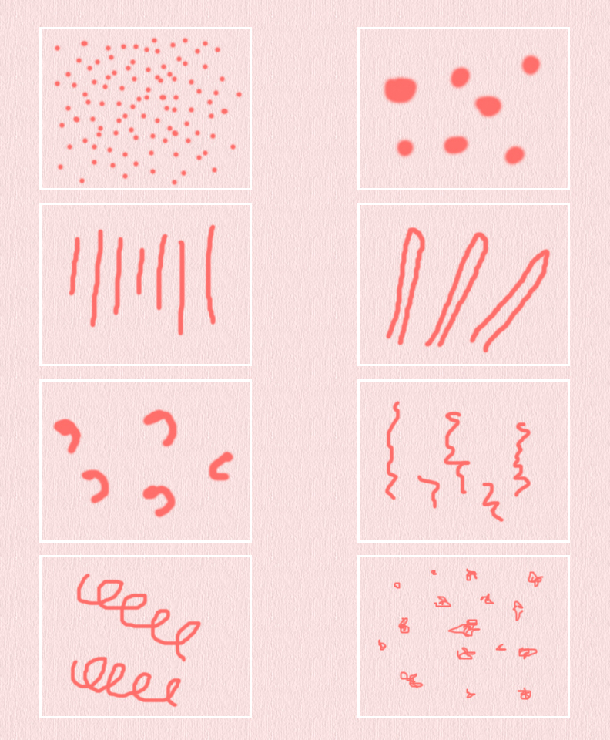
Dots
Clods
Lines, straight
Lines,
looped
Lines,
curved
Lines,
serpentine
Lines,
helical
Lines,
coiled

Slide 5
Dots
Clods
Lines, straight
Lines,
looped
Lines,
curved
Lines,
serpentine
Lines,
helical
Lines,
coiled

Slide 6
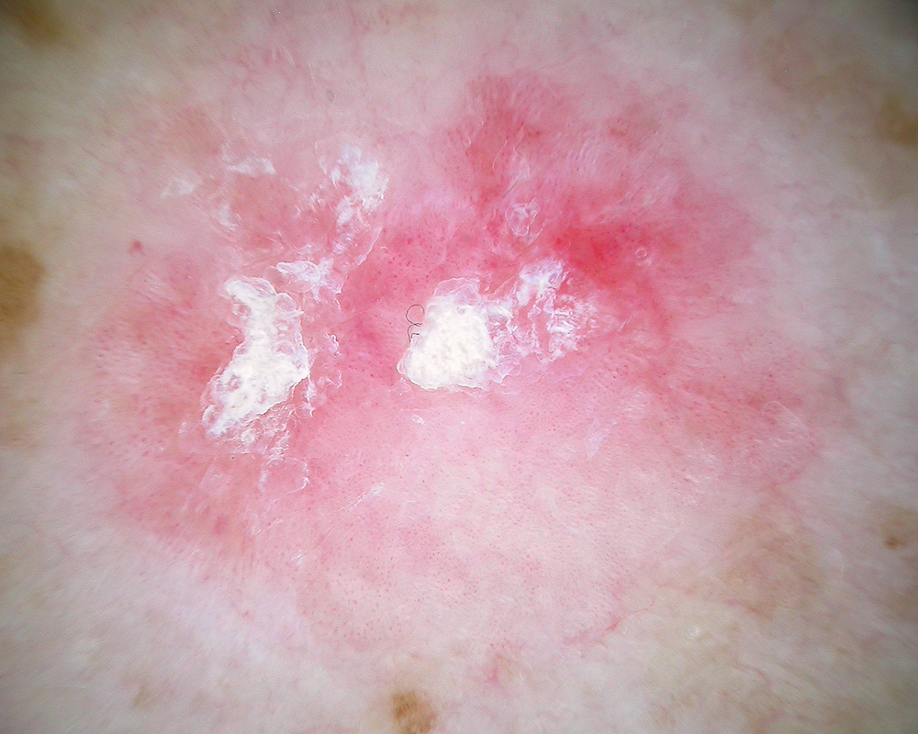

Slide 9
Vessels as dots = capillary loops in dermal papillae

Slide 11
Clods
Dots
Lines,
straight
Lines,
looped
Lines,
curved
Lines,
serpentine
Lines,
helical
Lines,
coiled

Slide 12
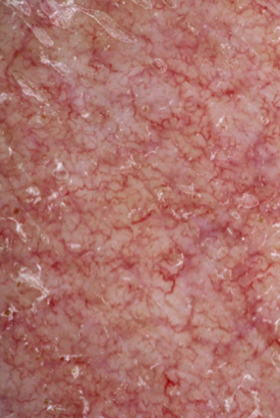

Slide 15
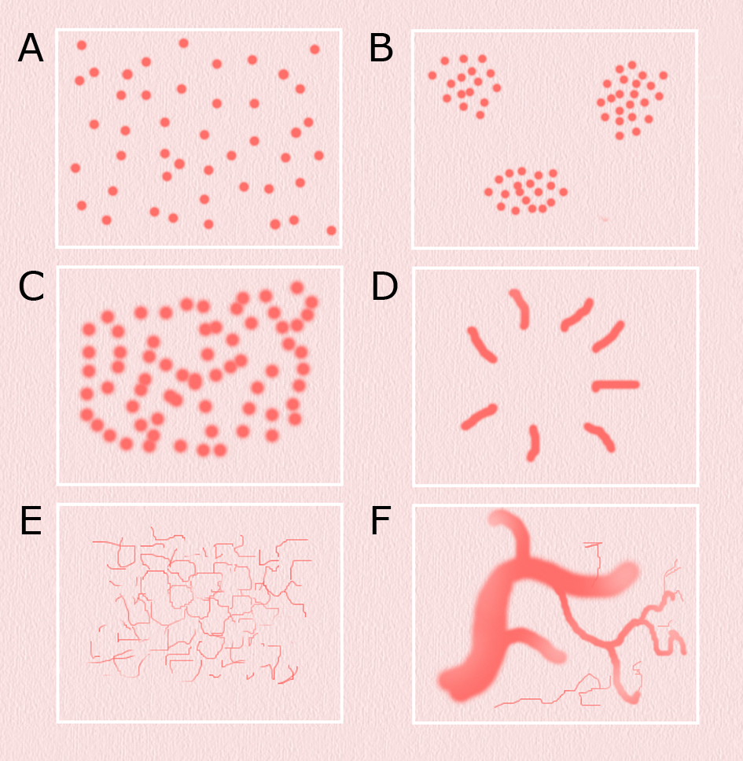

Slide 17
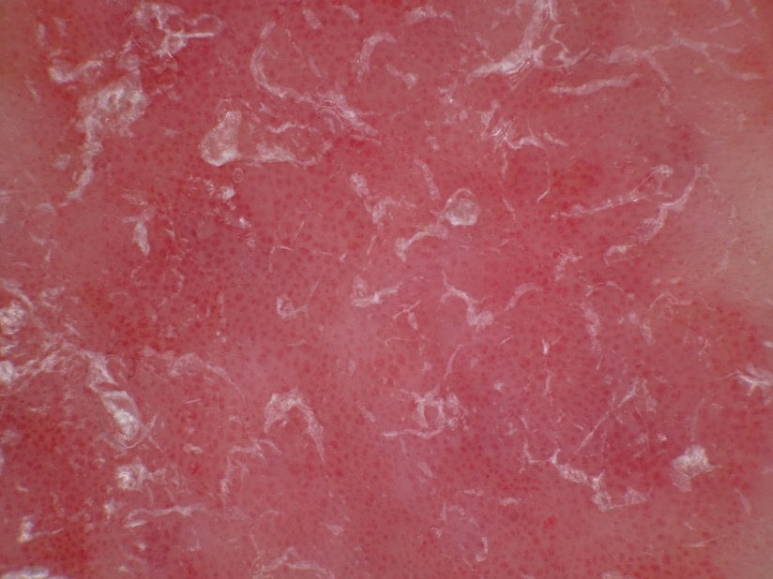
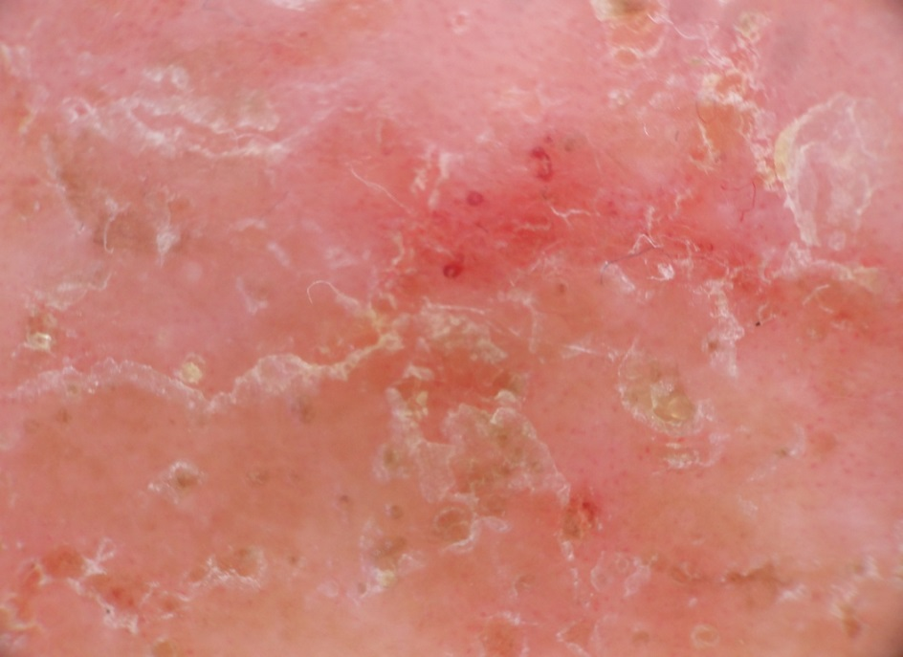
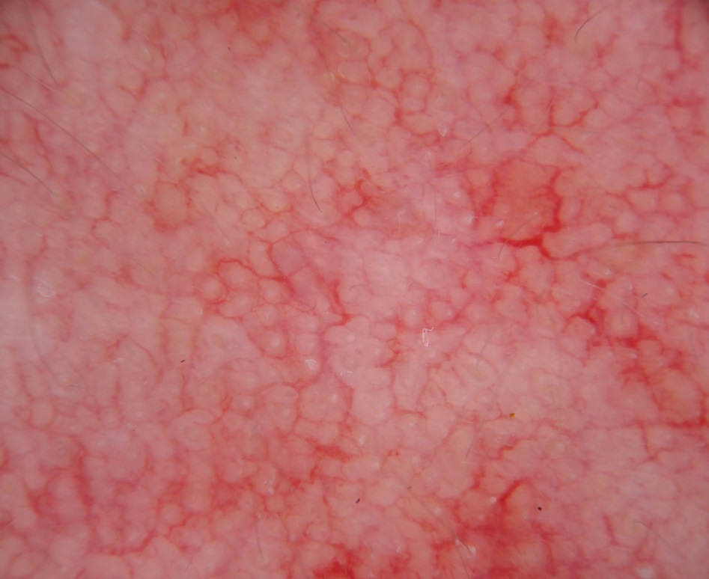

Slide 18
Important dermatoscopic criteria
Vessels
Scale
Follicular structures
Background
Clues

Slide 19
central
peripheral
diffuse
peripheral

Slide 20
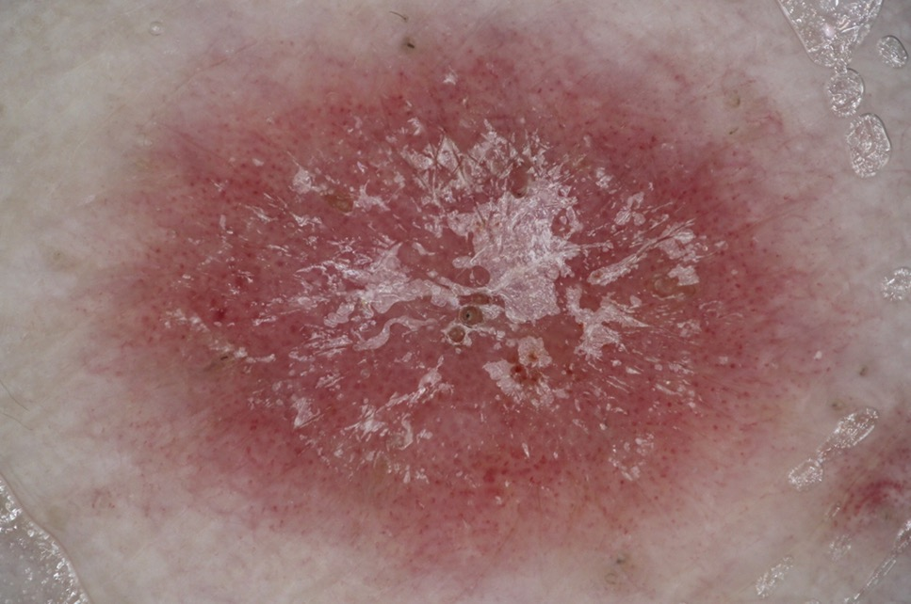
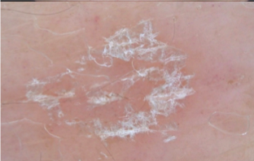

Slide 22
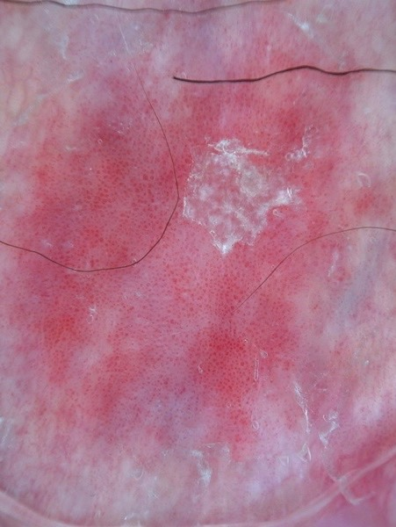
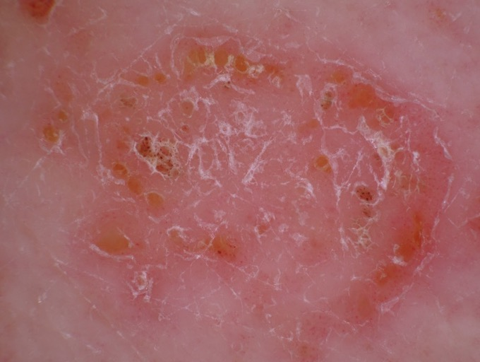

Slide 25
Important dermatoscopic criteria
Vessels
Scale
Follicular structures
Background
Clues

Slide 27
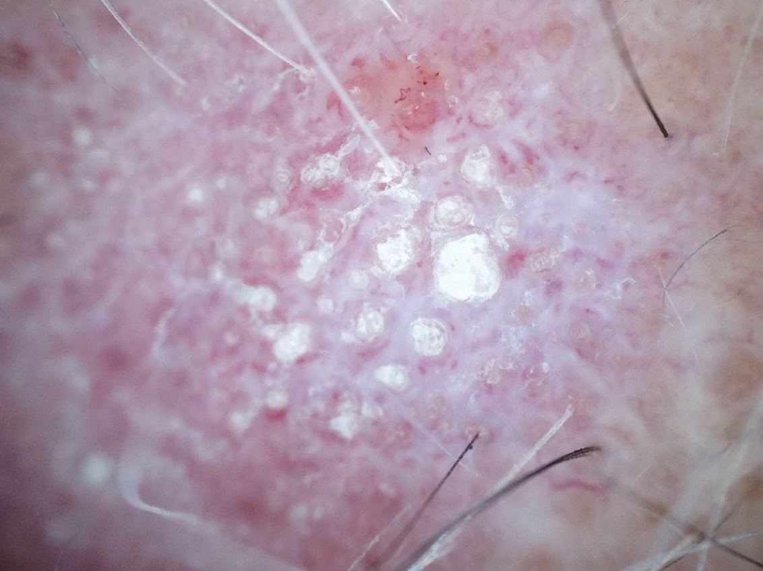

Slide 28
Important dermatoscopic criteria
Vessels
Scale
Follicular structures
Background
Clues

Slide 29
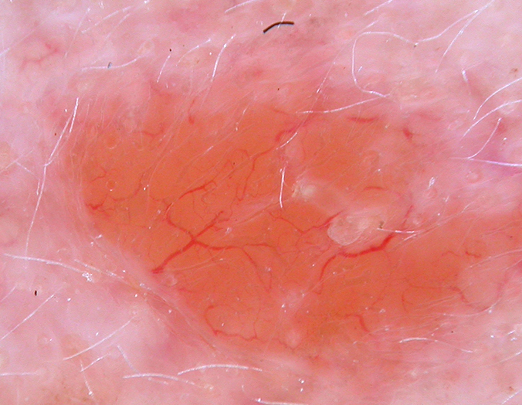

Slide 30
Important dermatoscopic criteria
Vessels
Scale
Follicular structures
Background
Clues

Slide 31
