Slide 1
Dermoscopy in general dermatology
Aimilios Lallas

Slide 2
1. Placing dermoscopy in the daily clinical routine

Slide 3
Diagnosis…
Clinical examination
Laboratory investigations
Imaging examinations
???

Slide 4
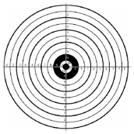
macroscopic inspection
history
palpation
diascopy
symptoms
scratching

Slide 5
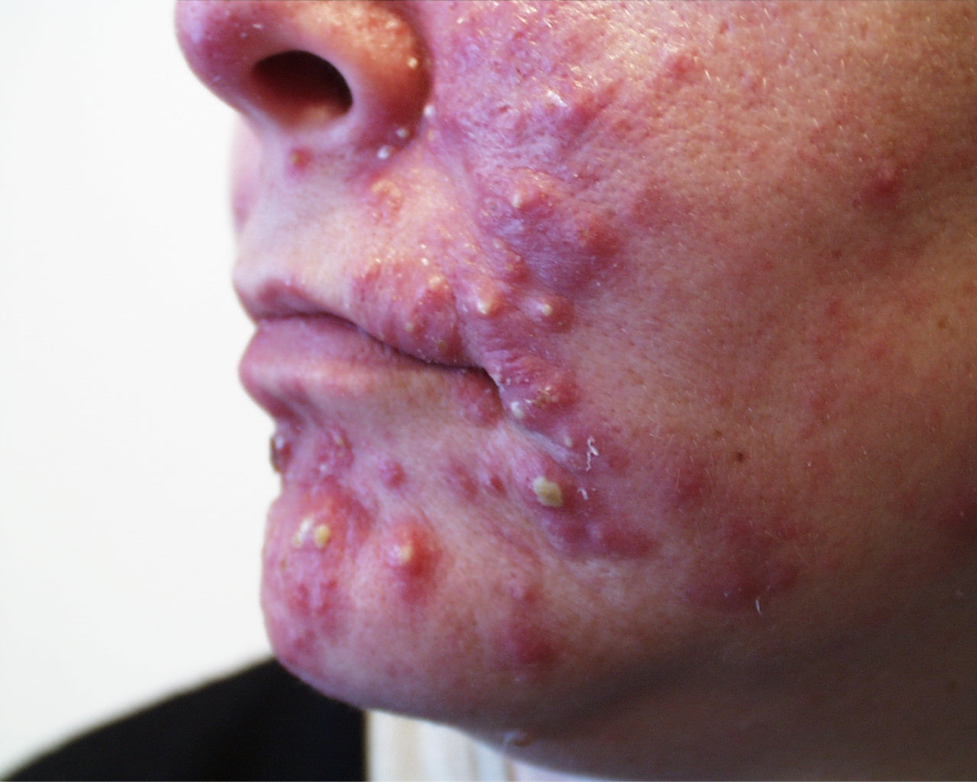

Slide 8
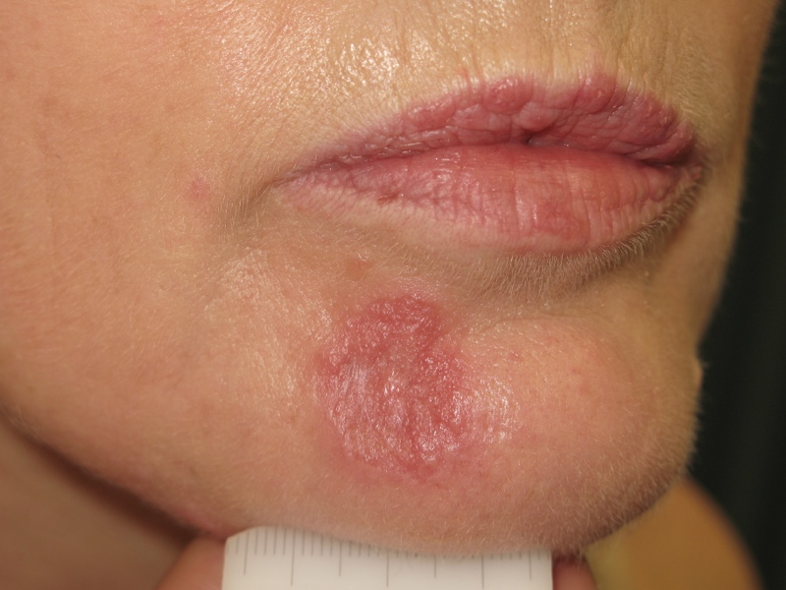

Slide 9
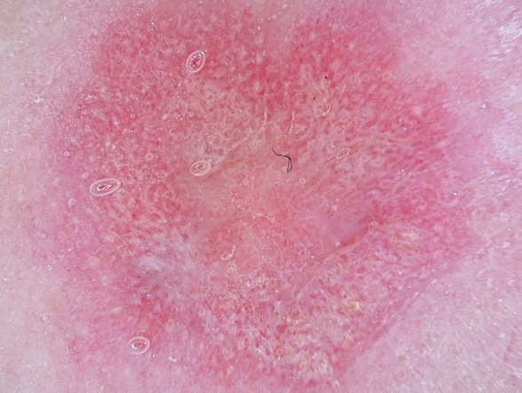

Slide 10
macroscopic inspection
history
palpation
dermoscopy
diascopy
symptoms
scratching

Slide 11
2. when should we apply dermoscopy ???

Slide 12
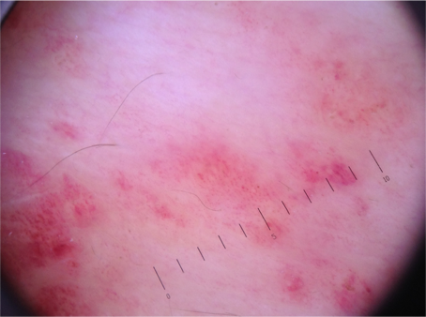
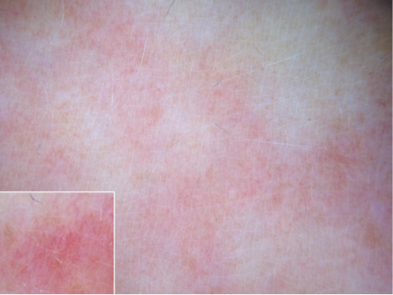

Slide 13
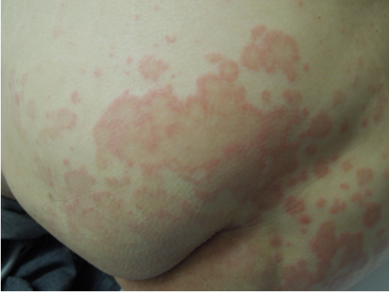
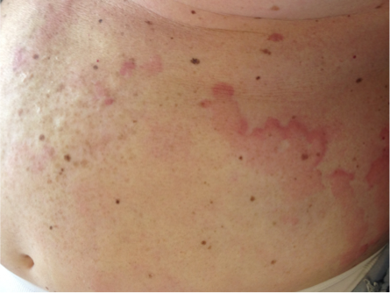

Slide 15
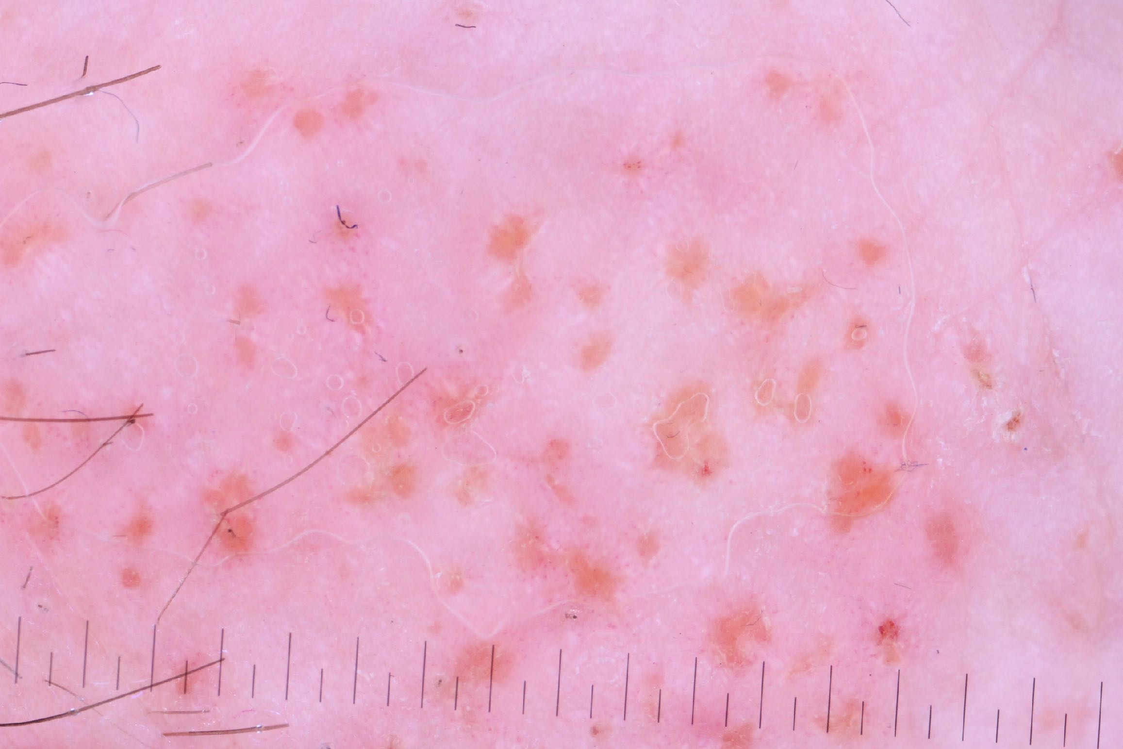

Slide 16
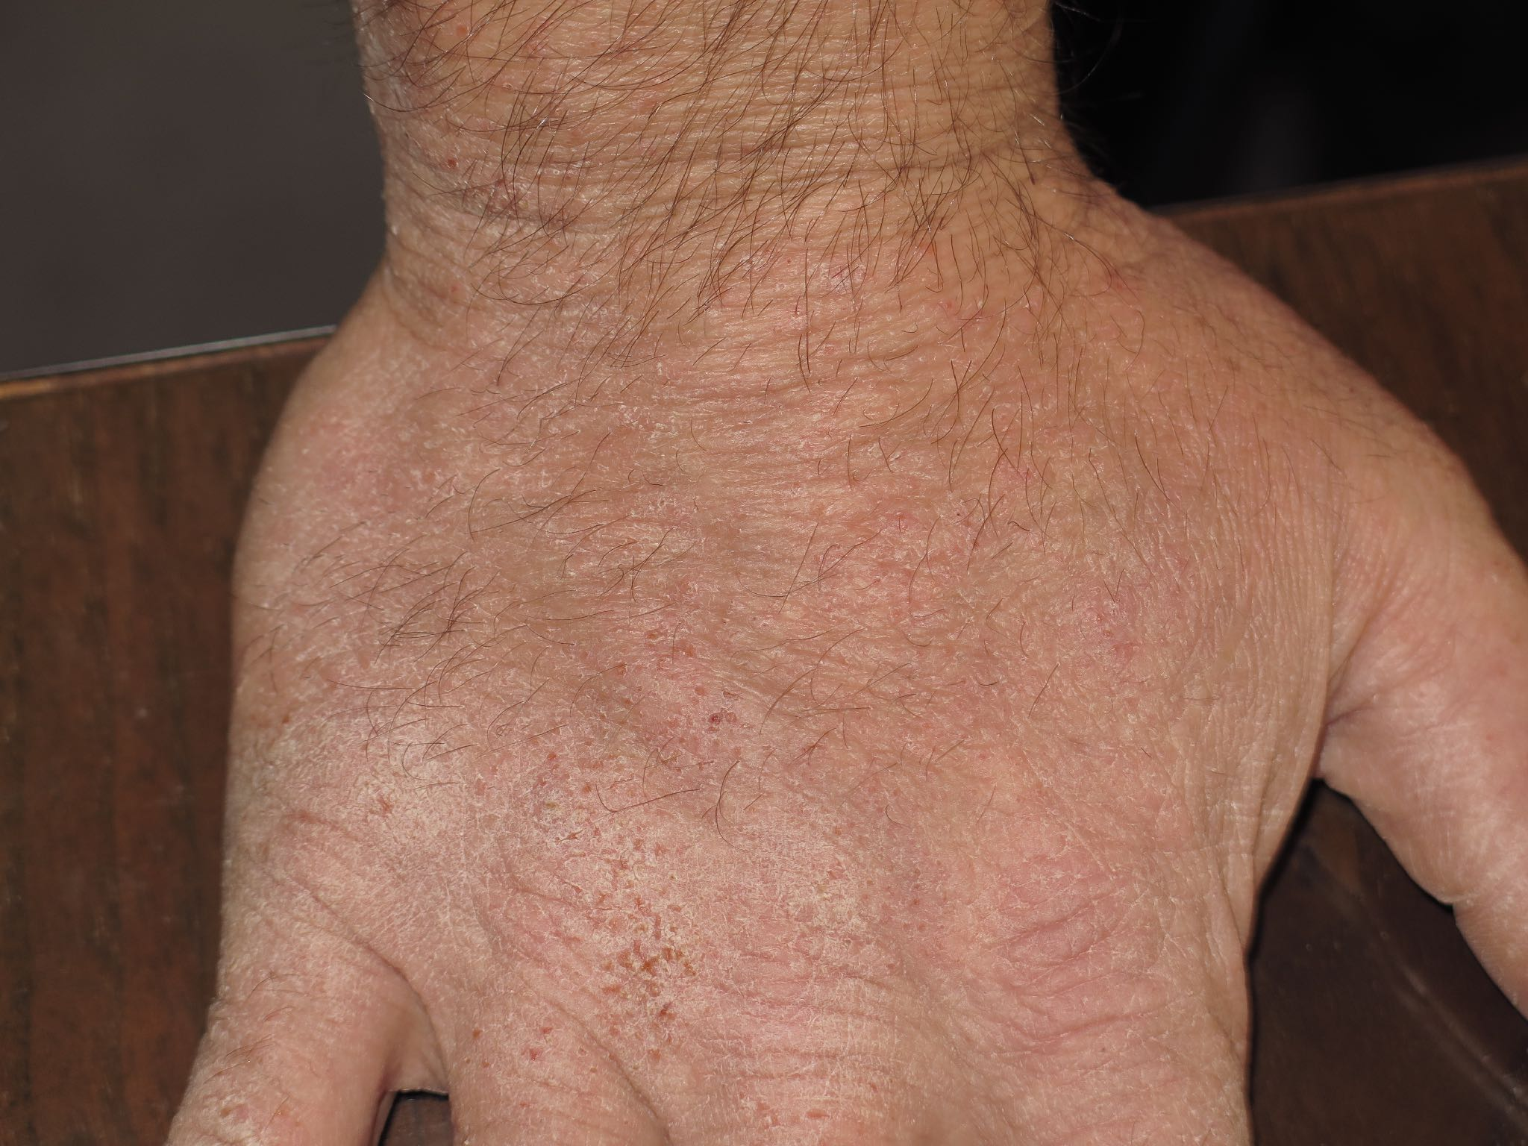

Slide 17
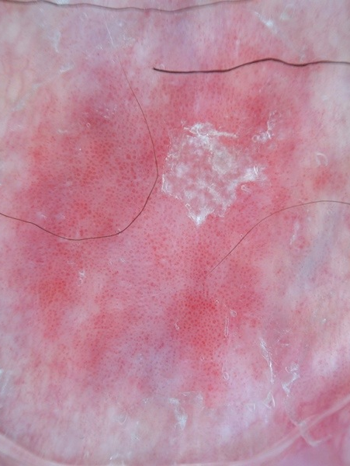
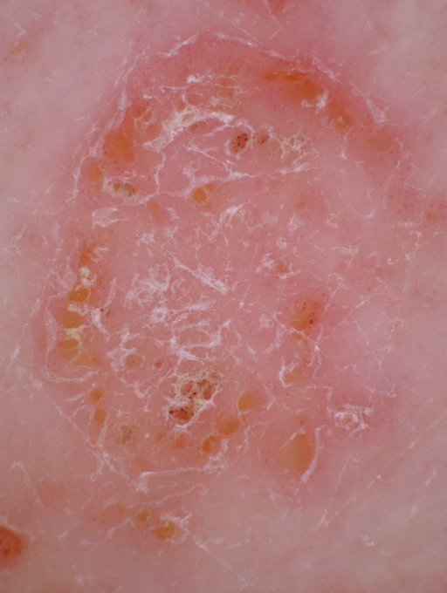
psoriasis
dermatitis

Slide 19
In the real clinical setting the diagnosis is often straight-forward

Slide 20
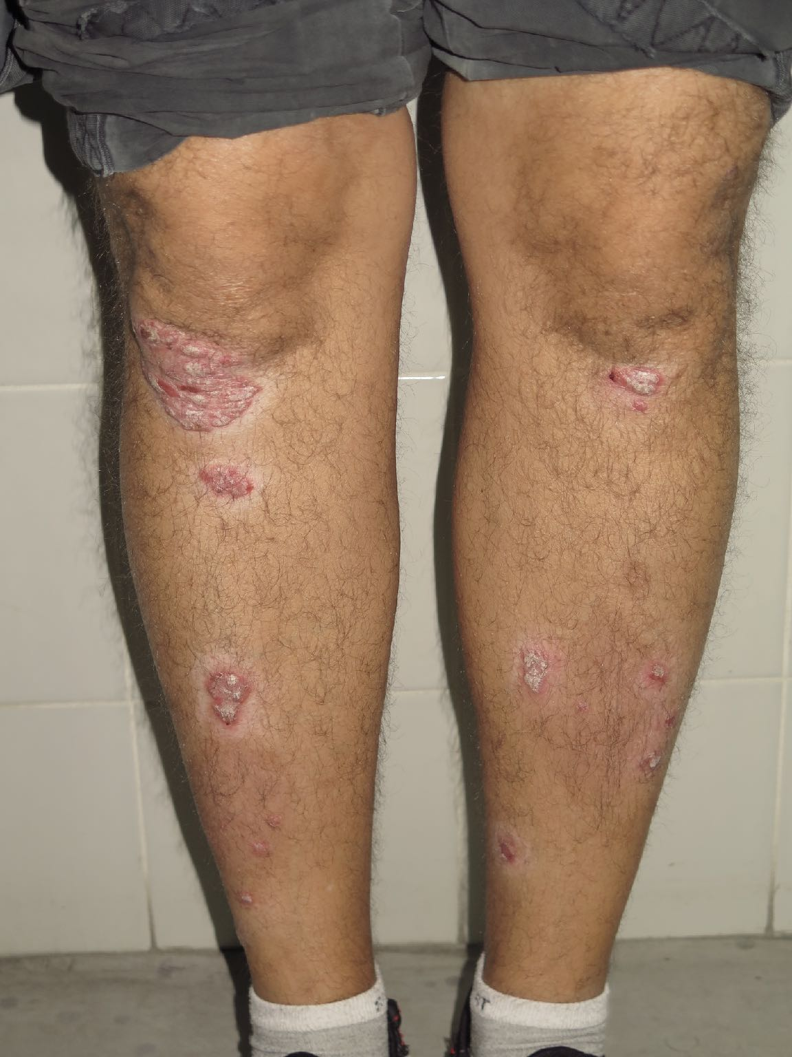

Slide 21
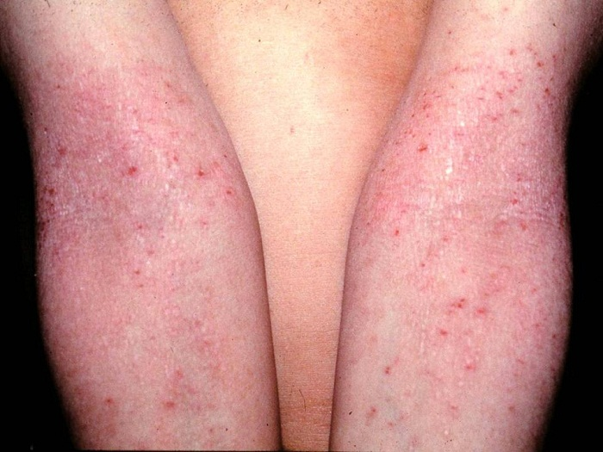

Slide 22
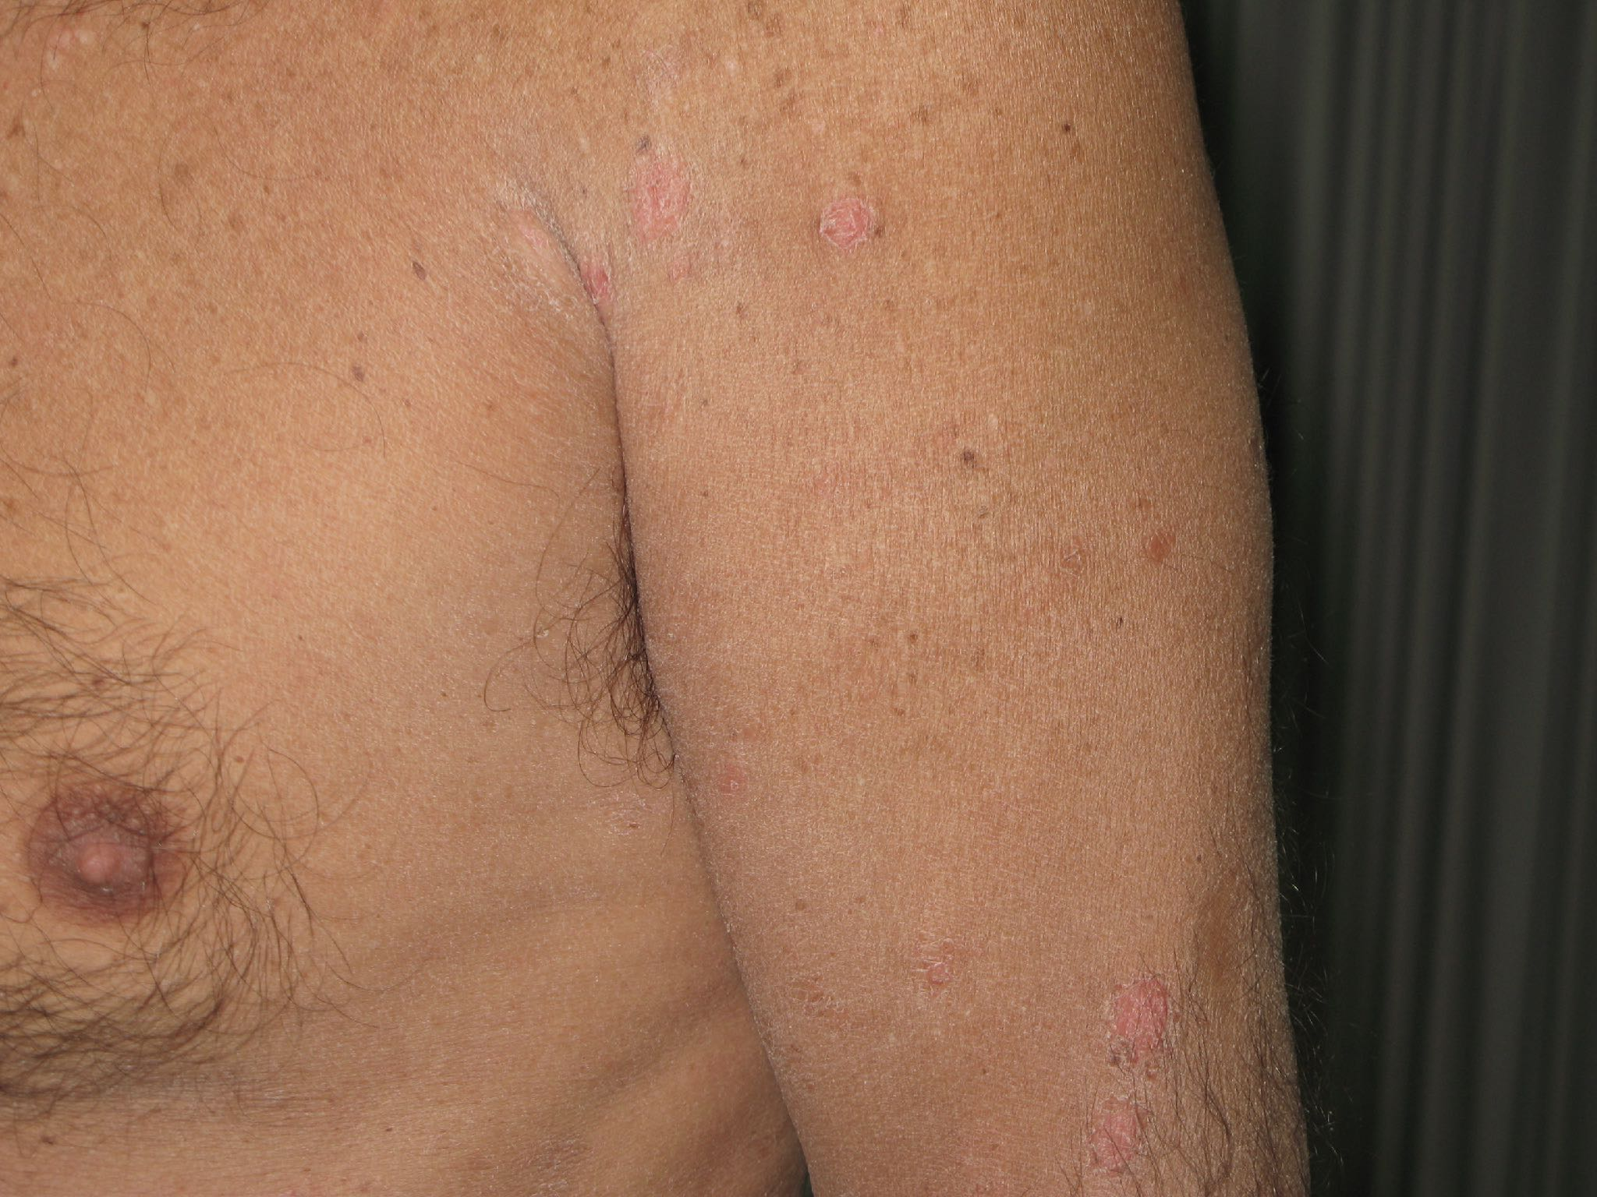

Slide 23
1. Dermoscopy is a part of the clinical examination
2. Dermoscopy makes sense only within a specific clinical differential diagnosis!!!

